Slide 1
Weekly Update 4
Sarang Deb Saha

Slide 2
IUDX Insights
Problems with the FIR data. Portal issues.
Pivot towards a new ‘Safety’ topic.

Slide 3
FIR data
Unavailability of lat-long data, hence have to depend upon Police station coordinates and work with black spot coordinated for prediction of severity in and around black spot areas itself.
BTP is yet to send in the digital FIR data.

Slide 4
New Problem statement aiding Road Safety
Traffic junction data for violations along with the video data of such incidents then do a cause analysis and provide insightful solutions to the particular violations And implement this as a real-time solution for all of the cameras around the city.

Slide 5
For scraping data and creating datasets
Using the BeautifulSoap library and parsing the HTML sites to select particular features.

Slide 6
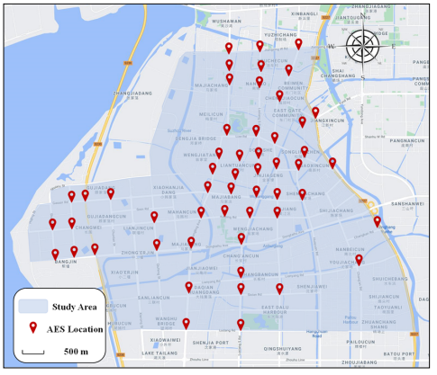
Analysis and Prediction of Intersection Traffic Violations Using Automated Enforcement System Data
Yunxuan Lia , Meng Lia,*, Jinghui Yuanb , Jian Luc , Mohamed Abdel-Atyd
53 AESs

Slide 7
Insights
The automated enforcement system (AES) is an effective way of supplementing traditional traffic enforcement, and the traffic violation data from AES can also be effectively used for safety research.
The potential factors influencing violations include 24 independent factors related to time, space, traffic and weather.
Results from a logistic model showed that the midday period, weekends, residential districts, collector roads, congested traffic conditions, high traffic flow, lower wind speed and low temperature would increase the probability of traffic violations.

Slide 8
4. The probability of violations was predicted by the random forest algorithm, which was proven to be the best traffic violation prediction model among logistic regression, Gaussian naive Bayes, and support vector machine.
5. The proximity weighted synthetic oversampling technique (ProWSyn) method was applied to reduce the impact of the imbalance ratio (IR) and improve the model’s prediction performance.

Slide 9
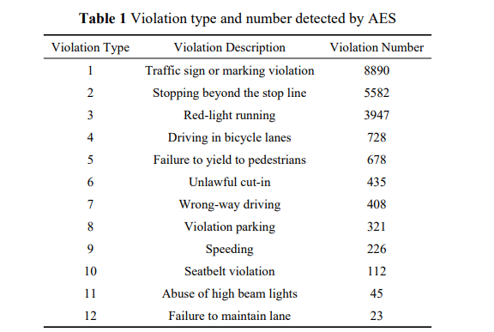
Violation Types and Frequencies

Slide 10
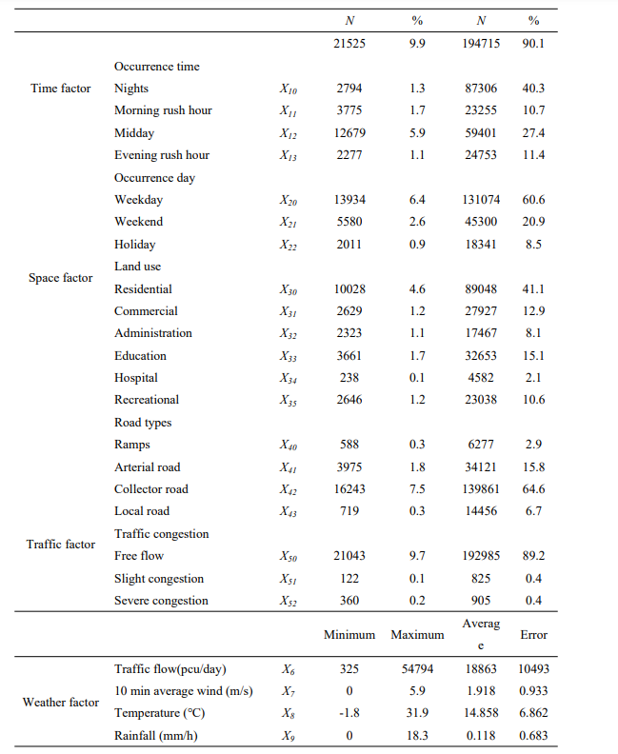
Influencing Factors
The road types include: 11 ramps, 70 arterials, 112 collector roads, and 19 local roads.

